Slide 1







TreeDAlgo
Being in the heart of software component innovation for modeling and solving complex problems involving multiple optimisation criteria
23 rue Massena
Casablanca
Tel. 25 35 09 Fax. 25 35 58
http://www.TreeDAlgo.co.ma
ECSPLAIN Consortium
ECSPLAIN OBJECTIVES
  To develop methods, techniques and generic software, making it possible to address planning scheduling problems in a systematic manner, thus insuring quality solutions to complex, constrained optimisation tasks.
  To focus on the resolution of over-constrained problems and of problems involving multiple optimisation criteria and/or a wide variety of preference constraints
  To enable complex industrial problems to be described explicitly, allowing the modelling of high-level requirements, multiple optimisation criteria and preferences to be captured
  To improve the efficiency and quality in several areas of industrial activity
ECSPLAIN Will Offer :
  Application modelling tools
  New algorithms integrated with state-of-the-art commercialized optimisation products
  A methodology for mixed-initiative resolution of complex, constrained optimisation tasks
  Practical guide to modelling & solving over-constrained problems,
  Running prototypes for industrial applications in construction, forestry, …
  Selectable search time limit for solution
  Multi-user functionality
  Dynamic schedule maintenance
  Continuous optimization
  Publications in international journals, conferences ...
  User friendliness
SGTM
(Morocco)
Norskog
(Norway)
TreeDAlgo
(Morocco)
SINTEF
(Norway)
ILOG
(France)
CSIC-IIIA
(Spain)

Slide 2

SYSTEM ARCHITECTURE
Constraint Application
Modelling Tools
Forestry Problem
Tunneling Problem
GUI for Interaction
with Users/Solvers
Constraint Solvers
Application
Models

Slide 3
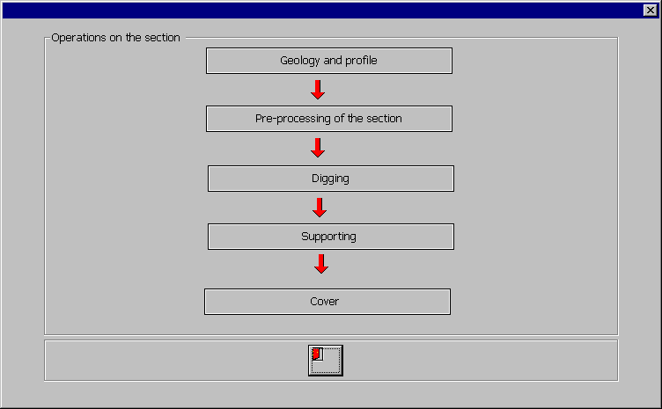
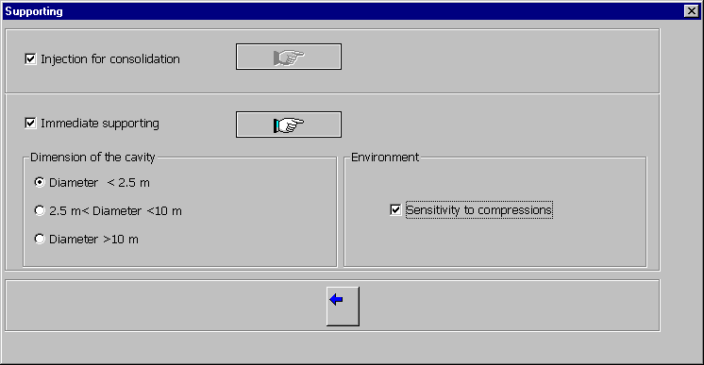
TUNNELING MODELLING TOOL (1)

Slide 4
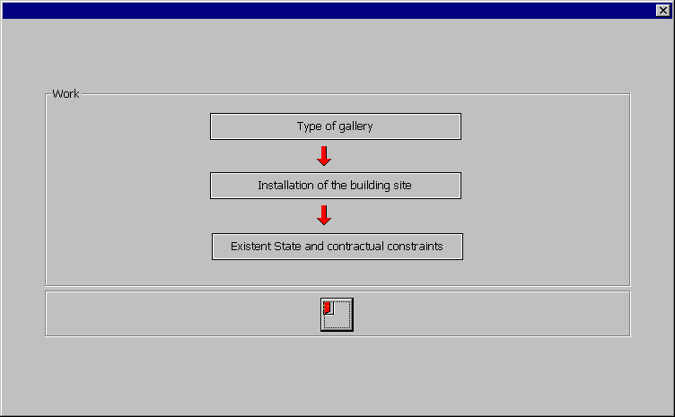
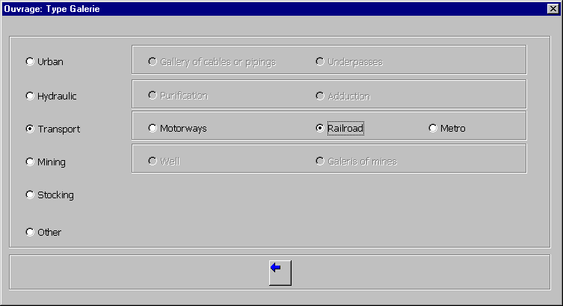
TUNNELING MODELLING TOOL (2)

Slide 5
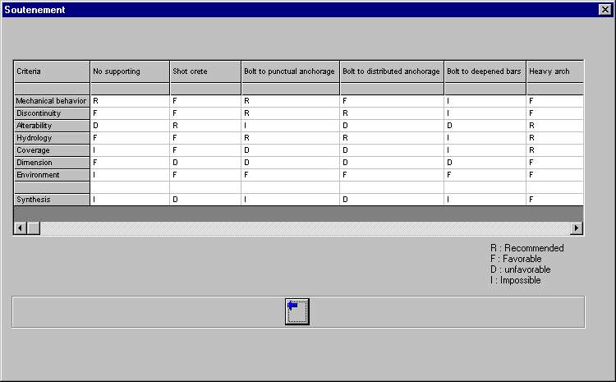
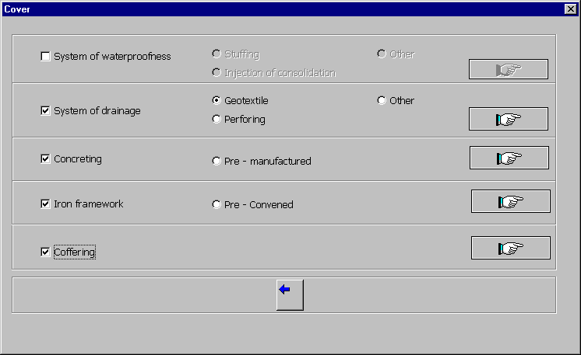
TUNNELING MODELLING TOOL (3)

Slide 6
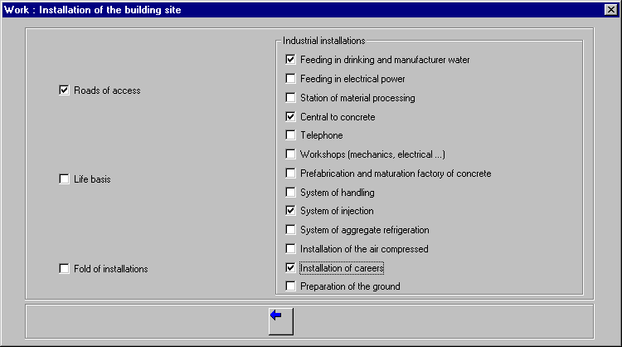
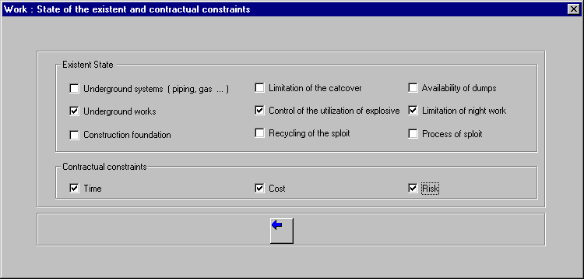
TUNNELING MODELLING TOOL (4)

